Slide 1
Blomo-link
John Semerdjian
Daniel Brenners
Wenqin Chen
Bryan Morgan

Slide 2
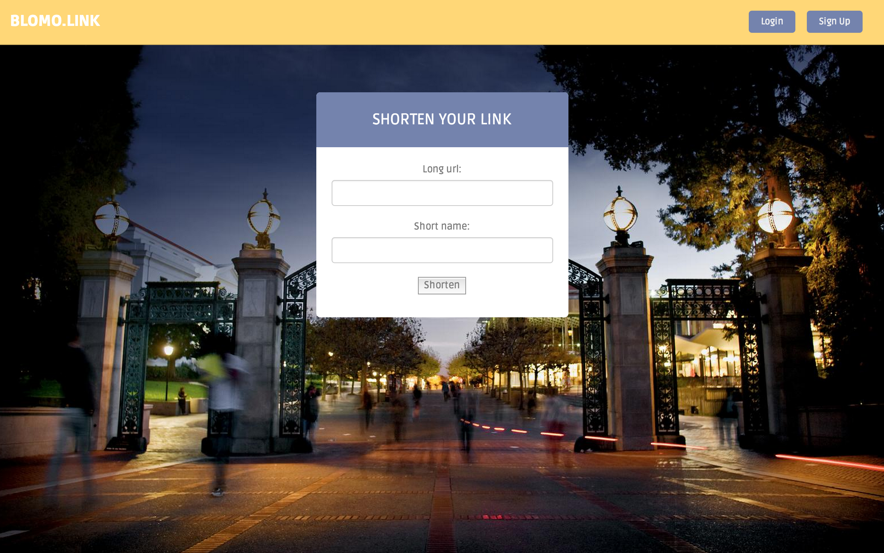

Slide 3
Features
Mobile Ready
User Profiles
Wayback Machine
PostgreSQL Database

Slide 4


Mobile ready

Slide 5
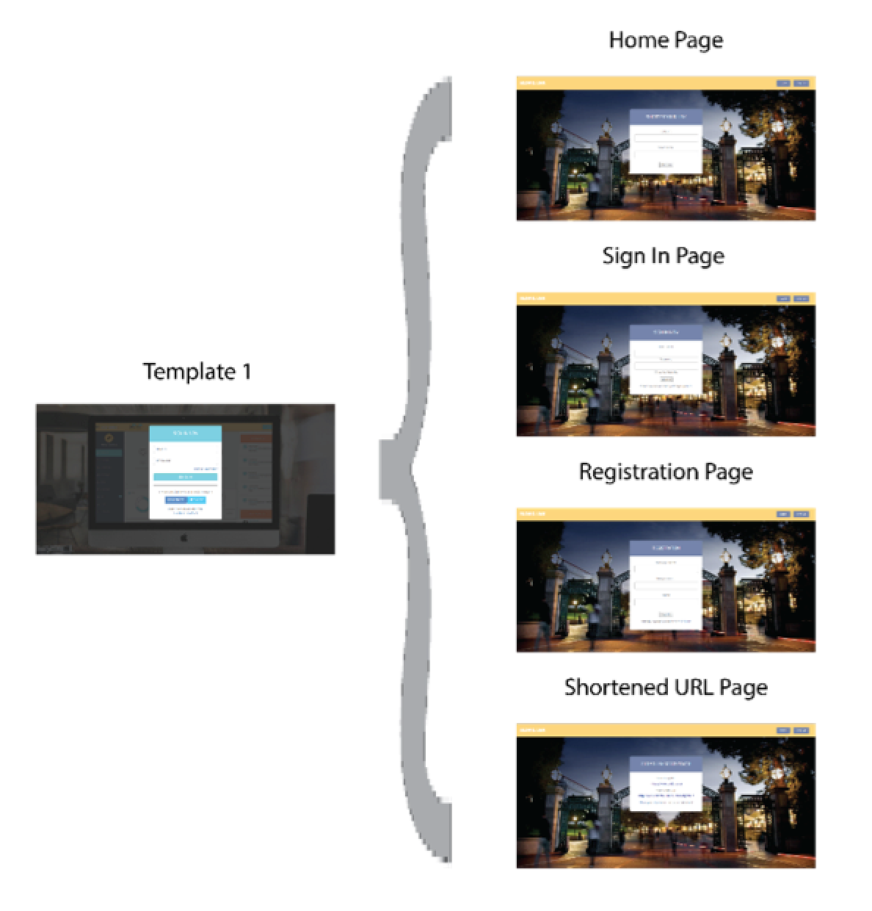
User profiles

Slide 6
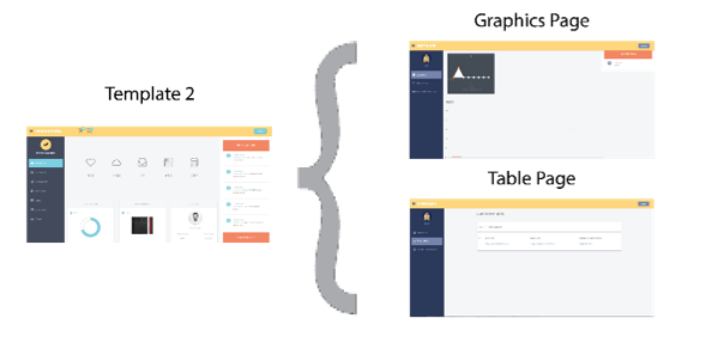
User profiles

Slide 7
Wayback Machine
We provided users with a link to their long url from a decade ago using the Wayback Machine.
1. {
2. "archived_snapshots": {
3. "closest": {
4. "available": true,
5. "url": "http://web.archive.org/web/20060101064348/http://www.example.com:80/",
6. "timestamp": "20060101064348",
7. "status": "200"
8. }
9. }

Slide 8
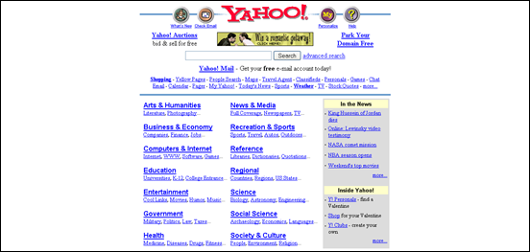
Wayback machine

Slide 9
Postresql database
Links
User
Clicks

Slide 10



Postresql database
Switched from MySQL to PostreSQL because it was easier to integrate with Heroku

